Slide 1
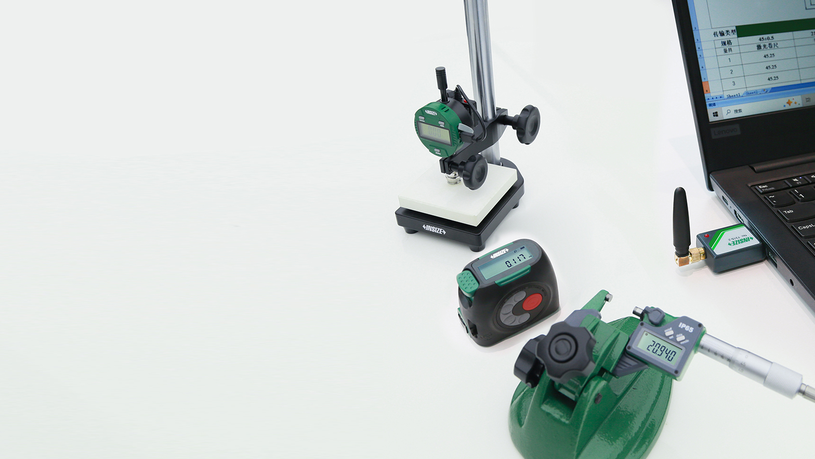

INSIZE
Quality Innovation Service Value
DATA
TRANSMISSION
AND MANAGEMENT
INSIZE INDIA LLP
www.insize.in
MEASUREMENT SOLUTION PROVIDER
V.1 05.2026

Slide 2




About us
INSIZE - Founded in 1995, is a dedicated supplier of measuring instruments. To enable us to serve the world-wide market, we are setting up an INSIZE distribution network on a global basis. INSIZE headquarter is located in China. We have branch companies in Canada, USA, Mexico, Brazil, India, Turkey, Malaysia, Thailand, Vietnam, UAE, Spain, France, Italy, UK, Poland, Czech Republic, Romania, Slovenia, Australia and distributors in over 120 countries. We ensure that wherever you are, our INSIZE products have service and support that are within hands reach. Our dedication to Quality, Innovation, Service and Value has created a worldwide demand for the INSIZE products.
is our standard quality, made in China
is our premium quality, made in Europe

Slide 3

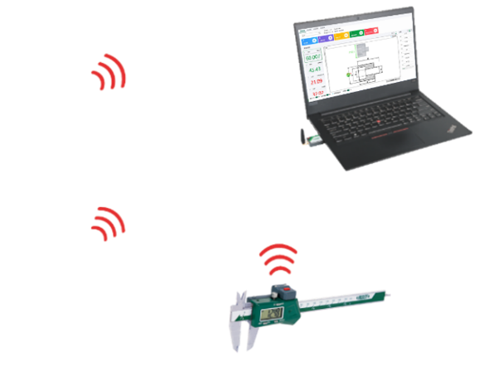

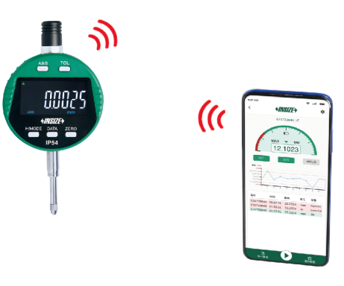
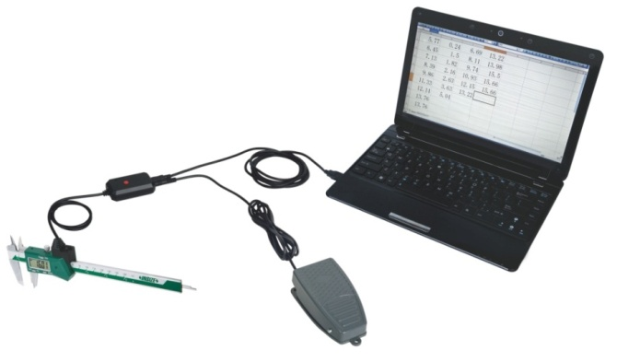




Data Transmission And Management
— Improve productivity
Supports multiple measurement tools for real-time data collection. One-click transfer of measurement data to Excel, measurement software or mobile APP after measurement. This process is efficient and accurate, and facilitates data management and sharing to improve productivity.
Transfer To Phone APP
Transfer To Excel
Transfer To Data Management Software

Slide 4
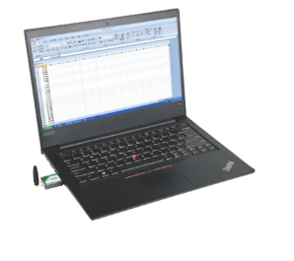


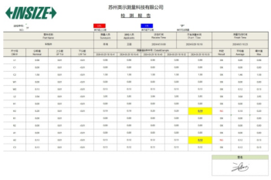


Advantages of Data Transmission (P1)
Communication Transfer Data
Traditional Measurement
VS
Traditional measurement is manual recording is inefficient, you need to measure and record at the same time; sometimes you need two operators for operation, one to measure and the other to record.
Timeliness
Data can be transmitted directly to a computer /phone through wired or wireless data transmission, improving efficiency.
Traditional measurements are made by manually recording data to a paper file or manually entering it into a computer, which inevitably results in recording errors.
Validity
The direct transmission of measurement data to the computer, eliminating human error and ensuring that the data is true.
Traditional measurements use paper forms, which are difficult to save , circulate and trace at a later stage.
Paperless
Compared to paper forms, electronic forms of data transmission are more convenient for storage, transferring between each other and later reference.

Slide 5
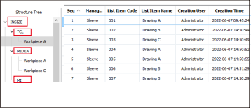
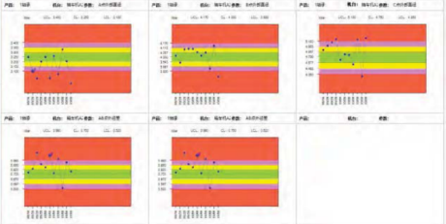
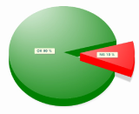
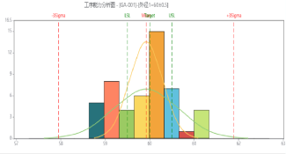
Advantages of Data Management (P2)
Data Acquisition
Supports multiple data collection methods,
compatible with mainstream measuring tools
data transmission
file parsing
screen capture
01
Work
Station
1
Supplier
3
Work
Station
2
Work
Station
3
Supplier
1
Supplier
2
OEMs
can be connected with PDM,
ERP, MES and other systems
Data Management
SPC analysis
Panel
Reports
Manages measurement data for
easy traceability and review.
Analyzes measurement data to identify production inefficiencies and optimize workflows.
Real-time monitoring of process quality to address risks promptly.
Provides inspection reports upon production completion, enhancing quality credibility.
defect rate
capability run chart
OEMs can conduct random inspections to verify if results align with those from suppliers and ensure full production traceability.

Slide 6


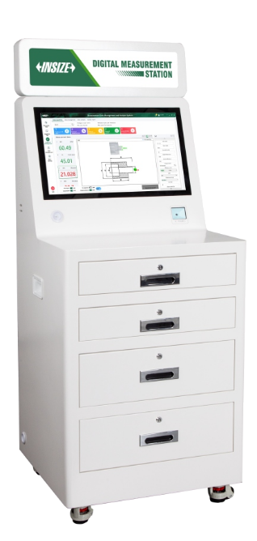
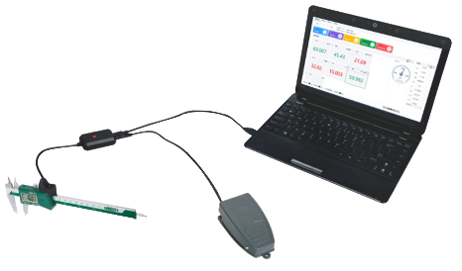
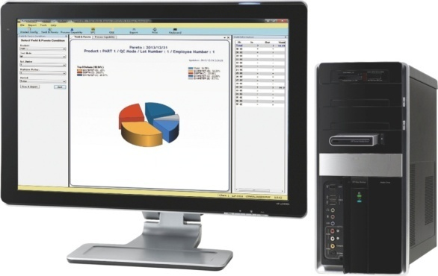
Agenda
01
02
03
04
Wireless Data Transmission
Wired Data Transmission
Measurement Data Management and Analysis Software
Inspection Table

Slide 7
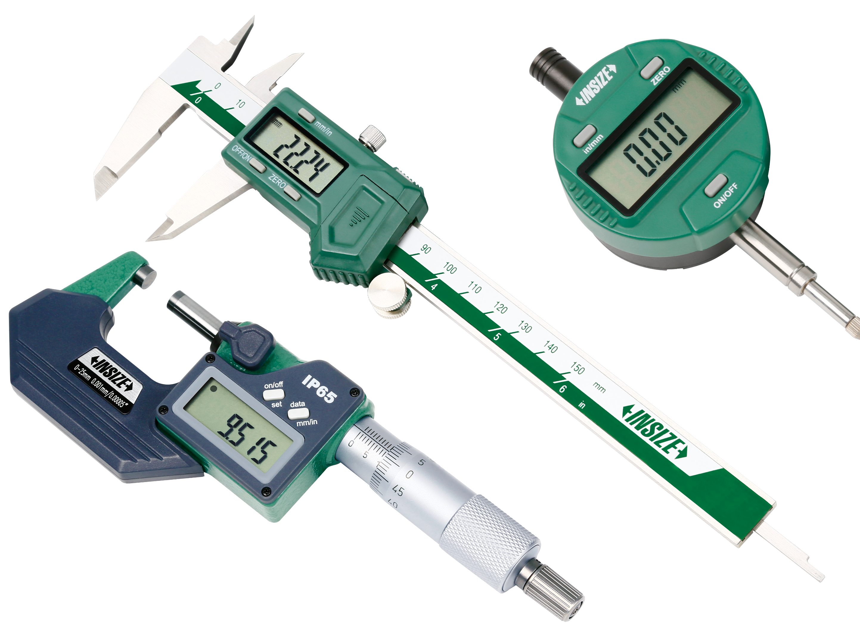

01
Wireless Data
Transmission

Slide 8
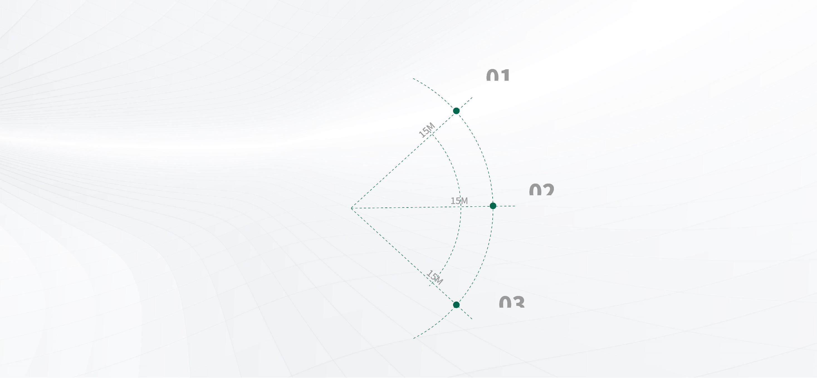
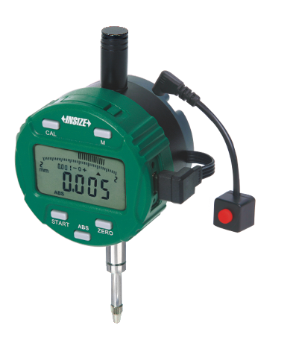
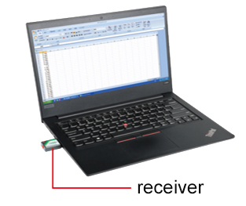
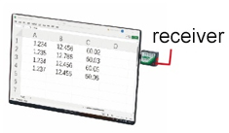
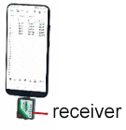
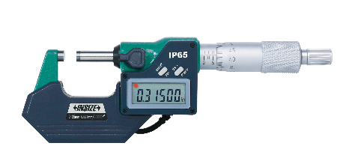
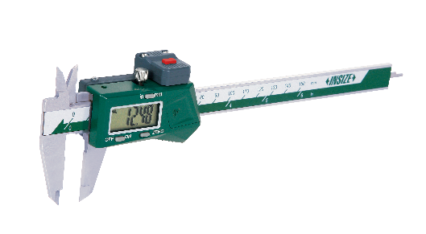
Wireless Data Transmission System
External Transmitter
Measuring tool connects to a transmitter to send data , and receiver received data
Trigger the transmit button of transmitter to wirelessly transfer measurement data to a computer /phone
Transmission distance : 15m (unobstructed, no electromagnetic interference)
Customizable AES128 data encryption to enhance data security
Transmitter
Connecting to
indicator
transmit button
Transmitter
Connecting to
micrometer
transmit button
Connects to PC/Phone/Tablet
transmit button
Transmitter
Connecting to
caliper

Slide 9
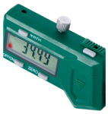
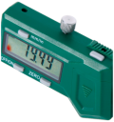
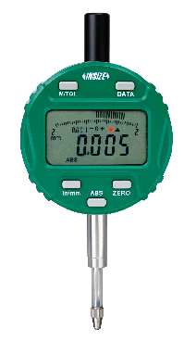

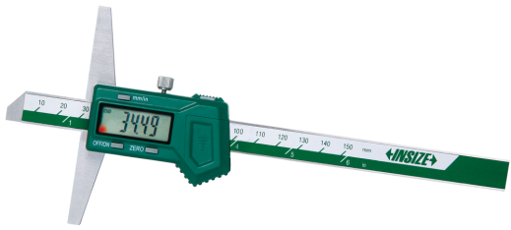
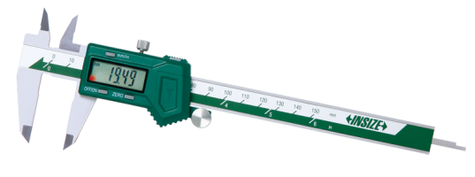
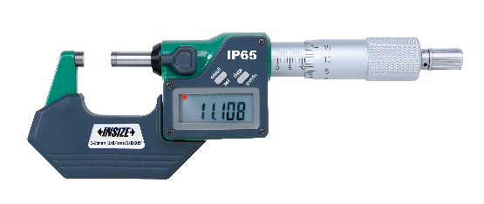
Wireless Data Transmission System
Built-in Wireless
The built-in wireless measuring tool sends data, and receiver received data
Transmission distance 10m(unobstructed, no electromagnetic interference)
Trigger the transmit button of measuring tool to wirelessly transfer data to the PC/phone
transmit button
transmit button
transmit button
transmit
button
signal light
signal light
signal light
signal light

Slide 10
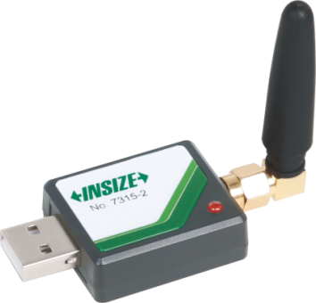
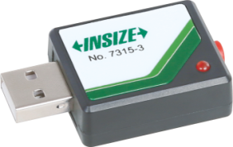
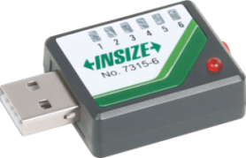
Receiver
The receiver connects to the transmitter or built-in wireless measuring tool, receiving data wirelessly.
Single Channel Receiver
(Keyboard Signals)
Multichannel Receiver
(Keyboard Signals)
Multichannel Receiver
(virtual com port)
can be connected to 1 transmitter
can be connected to 6 transmitters
can be connected to 16 transmitters, each has an unique identification code
For computers and mobile phone with Windows, Android, and iOS system
Recognized as HID keyboard device, the transmitted data is recognized by computers or mobile phones as keyboard input data and press enter key, such as 12.34 ↙
No need to install drivers and softwares.
Data can be transmitted to excel, word, txt etc.
For any softwares which can receive keyboard signal.
For computers with windows system.
Outputs serial port signals, to be used with software.
The data entry jump direction can be switched according to needs, either downwards or to the right. Custom output formats can also be tailored.

Slide 11
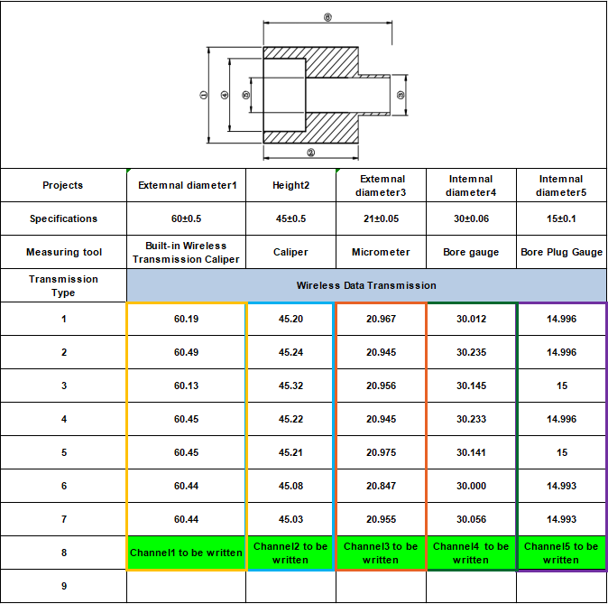
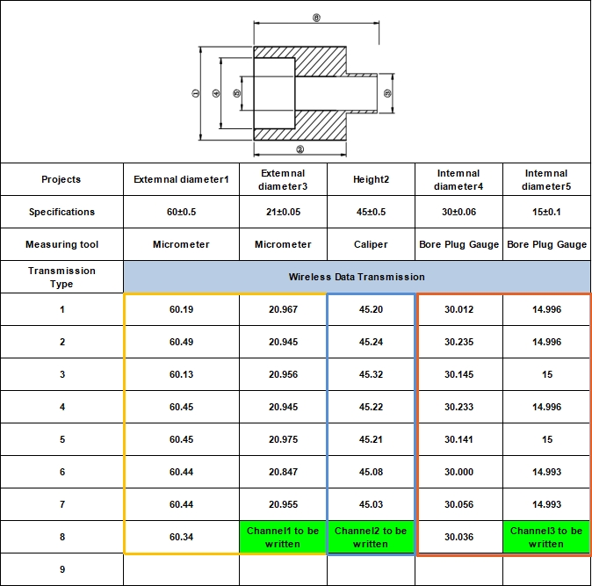
Excel Directional Input Software
(7315-2 Receiver Included)
The readings of measuring tools can be transmitted to the designated area of excel, which facilitates data management and improves efficiency.

Slide 12
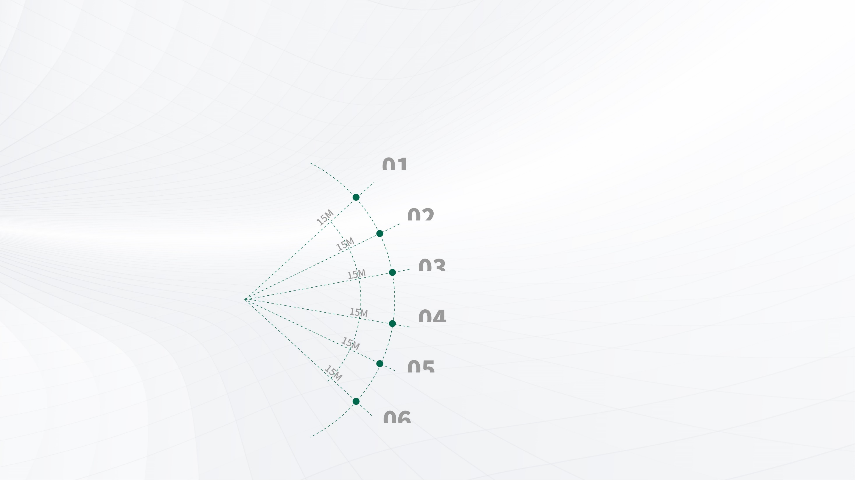
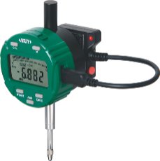
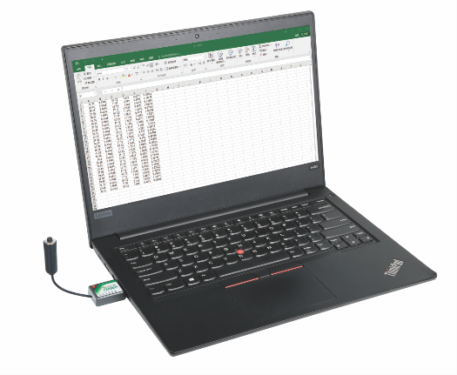
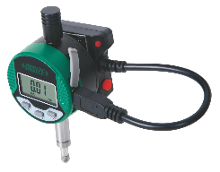
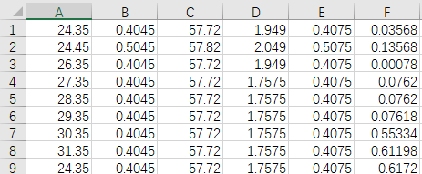
Wireless Data Transmission System of Digital
Indicators (Remote control) 7213
Digital indicator connects to a transmitter to send data, and receiver received data
Trigger the transmit button of receiver to transfer data from multiple digital indicators to computer/phone
Transmitter
Transmitter
Transmitter
transmit button
channel 1
channel 2
channel 3
channel 4
channel 5
channel 6
Transmitter
receiver
Transmitter
Transmitter
The button on receiver is pressed once, the readings of all digital indicators are transmitted

Slide 13
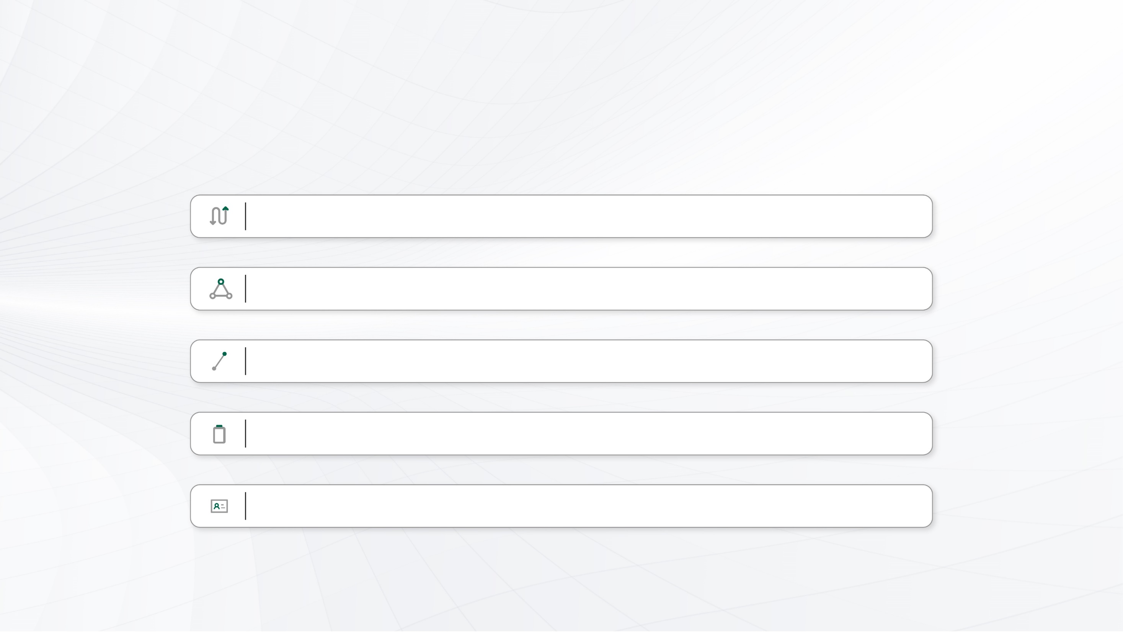
Wireless Data Transmission 7315 -- Advantages
Transmission distance: 15m (external transmitter), 10m (built-in transmitter).
Stable data transfer within the effective range, no data loss or errors.
Point-to-point transfer between measuring tools and collection terminal, with memory after
pairing—no need to reconnect.
Data can be transferred normally after rebooting the computer/phone, no connection required.
When transferring data, data with ID number is for easy identification of the source.

Slide 14
Wireless Data Transmission VS.
Competitor Brands Advantages
High Compatibility‌
Comprehensive Coverage‌
01
Our receivers feature multiple interfaces (USB, Type C, Micro USB, and Lightning), compatible with various system terminals such as computers, tablets, or phones
running Windows, Android, or iOS.
02
Three product categories: built-in wireless transmitters, external wireless
transmitters, and all-in-one transmitters. our wireless data transmission capability
comprehensively covers commonly used measuring tools and instruments.
Diverse Communication Protocols‌
User-Friendly Operation‌
03
Supports both ‌emulated keyboard signals‌ and ‌serial port signals‌ to accommodate
varied industrial scenarios.
04
Simplified device pairing, unpairing, and data transfer processes for effortless setup.
Persistent Binding Mechanism‌
Ultra-Low Power Consumption‌
05
06
Single-pairing ensures continuous data transmission—no re-pairing required
when replacing terminals, instruments, or batteries.
Operates for over ‌400,000 transmissions‌ on a single CR2032 battery.
Data Format
Data Security‌
08
07
Supports multiple data fomats: e.g., Value + Enter, Value + TAB, ID number + Value
+ Enter, etc.
Optional ‌AES128 encryption‌ for critical data protection.
Advanced Analytics Capabilities‌
Deep Customization‌
09
10
Mature supporting software collects, aggregates, and analyzes measurement data, enabling streamlined, intelligent, and visualized data management.
Provides bespoke data transmission solutions tailored to client specifications.

Slide 15
02
Wired Data Transmission

Slide 16
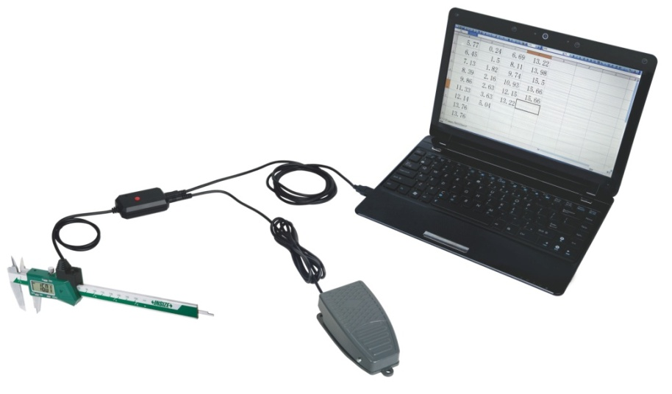
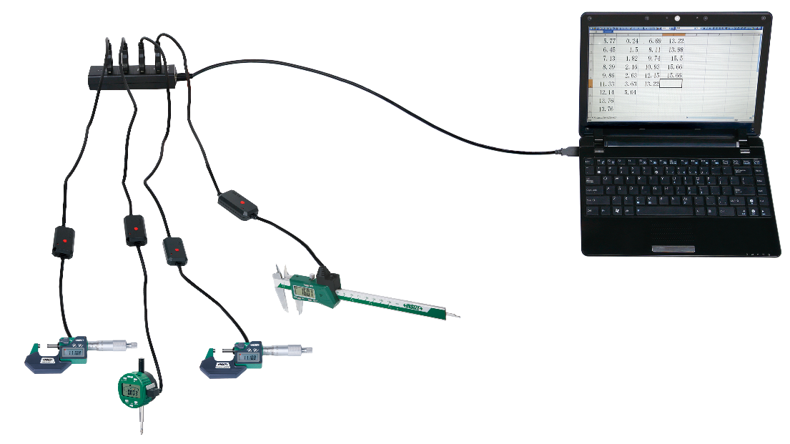
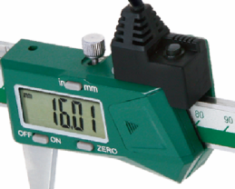
Wired Data Transmission (keyboard Signals)
7302
Measuring tool connects to the data output cable, and trigger the transmit button to wired transfer data to a computer/tablet
Connecting to caliper
Recognized as HlD keyboard device by computer, no need to install drivers and softwares.
Data can be transmitted to Excel, Word, txt and other files (press transmit button, which is recognized by the computer as keyboard input data and press enter key, such as 12.34↙).
For any softwares which can receive keyboard signal.
Cursor movement direction after data input can be switched (down/right).
Supports output of ID numbers if needed, e.g., 2023032265 12.34.
连接使用
press red button
to transmit data
can also press the foot
switch to transmit data (optional)
press black button to transmit data
Connecting to digital
indicator/micrometer

Slide 17
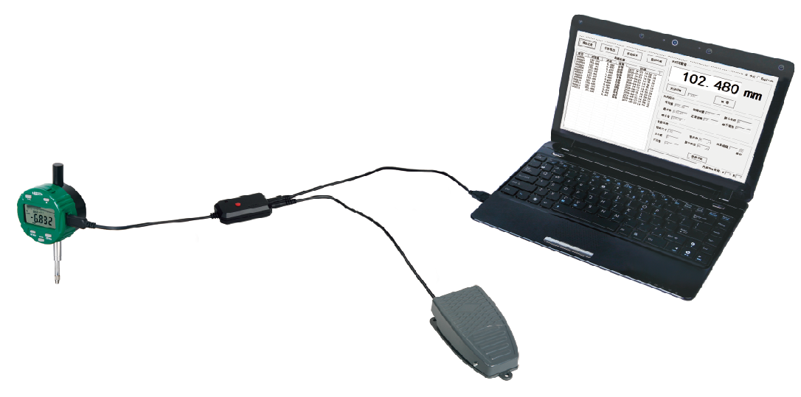
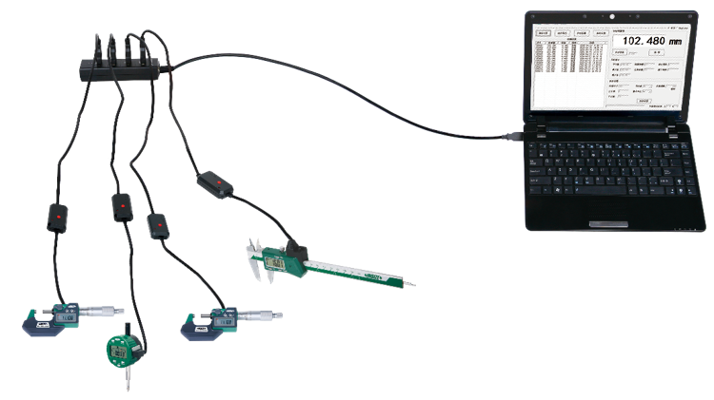
Wired Data Transmission
(Text Format, Virtual Com Port) 7305
Measuring tool connects to the data output cable, and trigger the transmit button to wired transfer data to a computer
Output serial signals to transfer data to serial communication software.
Supports output of ID numbers if needed, can designated area to input data from different measuring tool, e.g., 2023032265 12.34.
Connecting to digital indicator
press red button
to transmit data
can also press the foot
switch to transmit data (optional)
Connecting to digital
indicator/micrometer/caliper

Slide 18
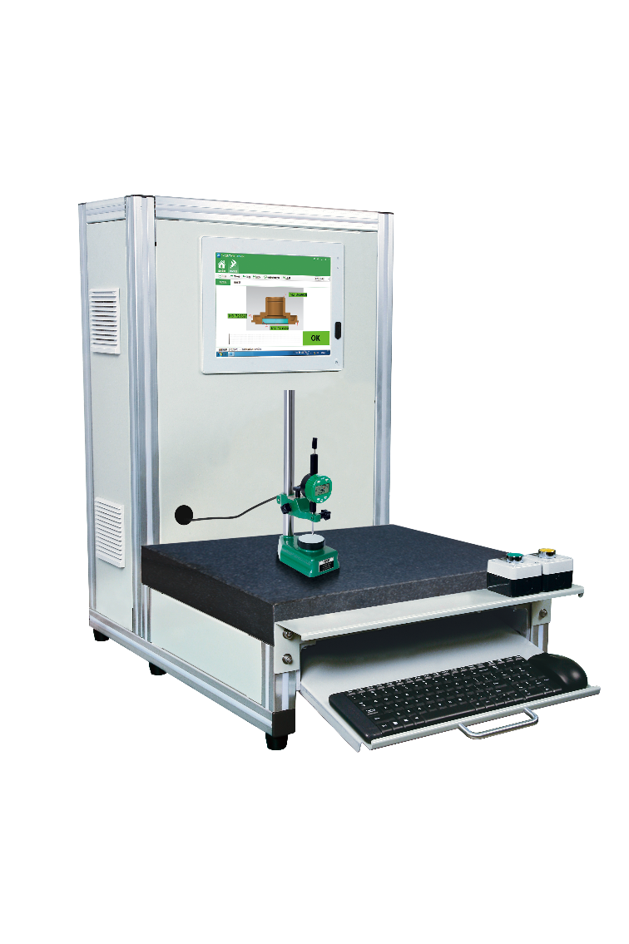
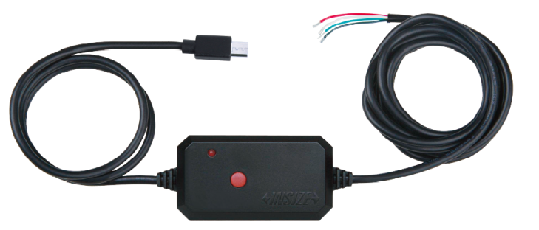
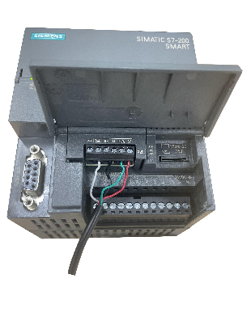
485 Data Output Cables 7215
Connect the measuring instrument to the data cable, and connect the data cable to the PLC to enable automated control of the measurement data.
PLC Control Panel
Automated Control System
7215-40M Data Output Cable(RS485)
Application
Modbus-RTU Protocol
• Configurable baud rates (9600, 19200, 38400)
Can set communication address

Slide 19

Wired Data Transmission Comparison
PK
7302 Series(Keyboard Signal)
7305 Series (Serial Signal)
7215 Series (485)
Adapted
Terminals
Computers or tablets with Windows, Android, or iOS systems (USB interface supported)
Computers or tablets with Windows system
(USB or RS232 interfaces supported)
PLC
(Terminal block)
text format, virtual com port
(a. connection to software that recognizes different channels and IDs
according to serial communication protocols and defines data entry area
for different measurement tools;
b. can also use the included software (included in the 7210-2
interface box) to transfer measurement data from multiple measuring
tools to the designated area in Excel for easy data management)
Modbus-RTU protocols
(Connecting a PLC for automated data control)
Communication
type
keyboard format (suitable for any software or APP
which can receive keyboard input values)
Data Collection Methods
Single key press transmission
Single key press transmission or
command transmission or
real-time continuous transmission
Command Transmission
Transmission Performance
Wired transmission directly transfers data through physical connections, offering strong anti-interference capability,
stable signals, high speed, and good security. It supports high-bandwidth data transmission.

Slide 20
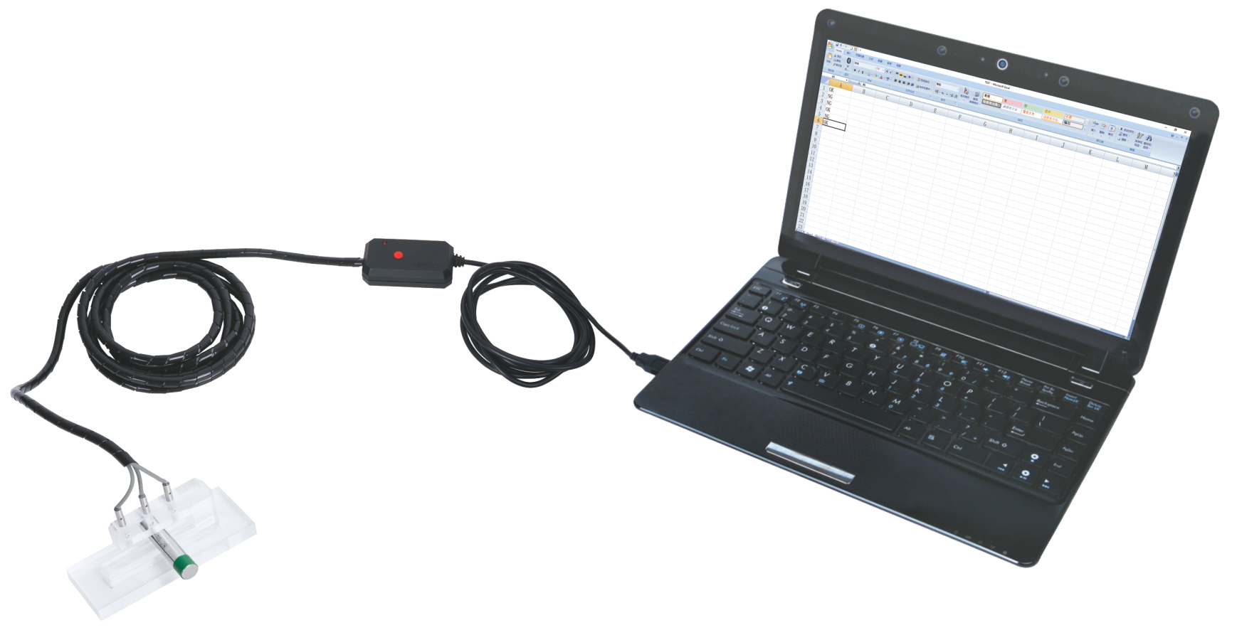
GO And NO-GO Signal Output Cable 7132 (P1)
Connects gauge with signal output cables, automatically judgment and wired transmitting the judgment result OK or NG to the computer.
output NG (out of upper tolerance)
output NG (out of lower tolerance)
GO and NO-GO signal output cable
output OK (within tolerance)
gauge
workpiece
Suitable for metal workpieces

Slide 21
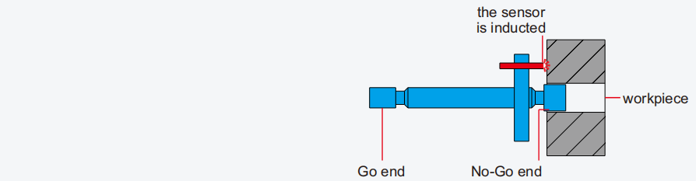
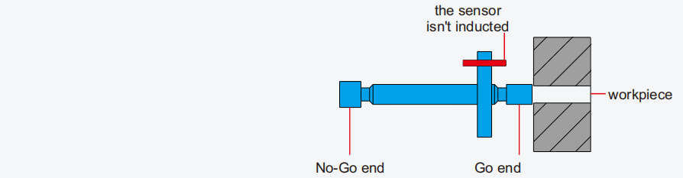
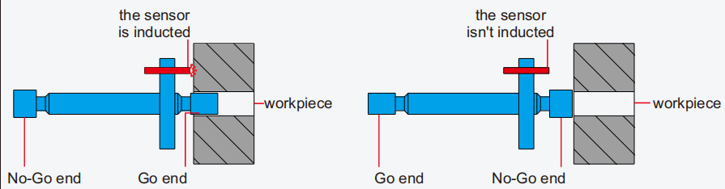
GO And NO-GO Signal Output Cable 7132 (P2)
Output cable with two sensors
If the No-Go end of gage can be inserted into the workpiece, it is out of upper tolerance and output NG
If the Go end of gage cannot be inserted into the workpiece, it is out of lower tolerance and output NG
If the Go end of gage can be inserted into the workpiece, but the No-Go end of gage cannot be inserted into the workpiece, it is within tolerance and output OK

Slide 22



GO And NO-GO Signal Output Cable 7132 (P3)
Output cable with three sensors
If the workpiece cannot enter into the upper tolerance section, it is out of upper tolerance and output NG
If the workpiece can enter into the lower tolerance section, it is out of lower tolerance and output NG
If the workpiece can enter into the upper tolerance section, but the workpiece cannot enter into the lower tolerance section, it is within tolerance and output OK

Slide 23


OK/NG Input switch 7327
Transmit the OK/NG results to the computer via a wired switch.
Output NG for appearance defects
Output OK for appearance qualified
hand switch
foot switch

Slide 24
Wired Data Transmission VS.
Competitor Brands Advantages
01
Adapted Terminals
Adaptable to multiple acquisition terminals
a. Computers or tablets with Windows, Android or iOS systems b. PLC
02
Multiple data communication types to meet various production application scenarios:
Communication
types
a. (Simulated keyboard signal) Directly transfer data to Excel reports or customer measurement software, MES, or ERP systems
b. (Output serial port signal ) Interface with serial communication software, or transfer measurement data from multiple gauges to the
designated area of Excel for easier data management
c. (485) Can be connected to a PLC to enable automated control of measurement data
03
Data Format
Supports multiple data formats: e.g., Value + Enter, Value + TAB, ID number + Value + Enter, etc.
04
Special Data
Types
Output the judgment result OK or NG

Slide 25
Measurement Data Management
and Analysis Software
03

Slide 26

Measurement Data Management and Analysis Software (Basic Version)-- 7349 （P1）
Automatically collects measurement data from measuring tools (e.g., digital calipers, micrometers, digital indicator , …), analyzes and manages the measurement data to improve production quality.
Software modules: Measuring tools management, inspection plan, data acquisition, data management, SPC analysis and quality reports
Measuring tools Management
Data management
Can be connected with
PDM,ERP, MES and other systems
Make inspection plan
SPC analysis
Data acquisition
Quality report

Slide 27









Measurement Data Management and Analysis Software (Basic Version)-- 7349 （P2）
Data acquisition
Data Transmission
Support multiple data acquisition methods:
Manual input: data input with keyboard
Data transfer: data collection with data output cable
Manual Input
Drawing-guided measurement, and acquisition
data of measuring tools
Measuring tool management
Data Management
SPC analysis
Quality report
Manage basic information and calibration dates of measuring tools.
Query measurement data (red display for out-of-tolerance) and result status (OK/NG, Rework, UpMax/LowMin).
SPC Analysis: average, min value, max value, range, Cp, Cpk, variation, sigma, counts of OK/NG.
Quality Analysis Control Charts: Pie chart, X chart, Xbar-R chart, Xbar-S chart, I-MR chart and Run chart.
Generate quality reports with control plan information, SPC parameters, and measurement data, can export Excel.

Slide 28


Measurement Data Management and Analysis
Software -- 7317 （P1）
Automatically collects measurement data from measuring tools (e.g., digital calipers, micrometers, digital indicator, …)
Automatically collects measurement data from file of CMM, Vision measuring tools, and other measurement tools.
Analyze and manage measurement data to improve production quality.
Software modules: Inspection plan, data acquisition, data management, SPC analysis and panel，quality reports.
Make inspection plan
SPC analysis
Management of inspection plan
Panel
Can Be Connected With PDM,
ERP, MES And Other Systems
Data acquisition
Report

Slide 29






Measurement Data Management and Analysis
Software-- 7317 （P2）
Data acquisition
Data transmission
Screen capture
Supports multiple data acquisition methods:
Manual input
Data transmission
File parsing
Screen capture
Manual input
File parsing
Guided measurement
Real Time Monitoring
SPC Analysis
Reports
Guiding the operator to measure follow the inspection plan to reduce human errors such as missed or incorrect inspections.
Quality control personnel can monitor real-time quality status for each process and address risks promptly.
Measurement data analysis helps identify engineering limitations and optimize workflows.
Quality reports increase quality credibility, reduce acceptance workload, and ensure traceable quality control.

Slide 30








Data Management APP
Measuring tools connects to the mobile APP by Bluetooth for real-time data collection
Displays synchronized data with automatic judgment (red display for out-of-tolerance)
Data trend charts help quickly identify abnormal fluctuations
Export data as PDF, JPEG, or Excel files
Transmission distance: 10 meters

Slide 31
04
Inspection Table

Slide 32



Digital Measurement Station -- 7906-06
The small and lightweight station is easy to move, and equipped with a 23.6-inch touchscreen computer (i7 CPU&Windows system)
CAN BE
CUSTOMILZED
Application
touchscreen computer
measurement data management
and analysis software
receiver
scan window(scan barcode
or QR code of workpieces)
data output cable
storage drawer
(customizable cavity)
L×W×H : 650x600x1617mm
foot switch
(transmission data)

Slide 33



Inspection Table
Customers can choose the suitable inspection table based on different measurement applications.
7901
7911
7923

Slide 34











SPC Inspection Station Case
1. Customer needs to quickly measure the inner and outer diameters of automotive differentials.
2. Measuring tools were selected for quick on-site measurements and to minimize human errors: 4653 precision
Bore plug gauge, 2186 quick dial snap gauge, and 4659 ring type inner/outer diameter plug gauge.
3. The 7315 wireless data transmission system was selected, and transmit data to the 7317 software.
transmitter
receiver
Ring Outer Diameter Plug Gage 4659-D250g6
(For measuring Ø250g6-0.015/-0.044)
Dial snap Gage 2186-125/275
(For measuring Ø105n6+0.045/+0.023/ Ø270h7 0/-0.052)
Bore Plug Gage 4653-B34J8
(For measuring Ø34J8+0.024/-0.015)
Using the 7315 wireless transmission system, measurement data is directly transferred to the 7317 software.

Slide 35

THANKS !
Quality Innovation Service Value

